Slide 1




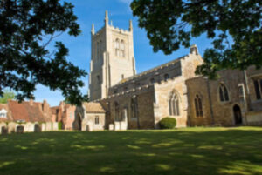
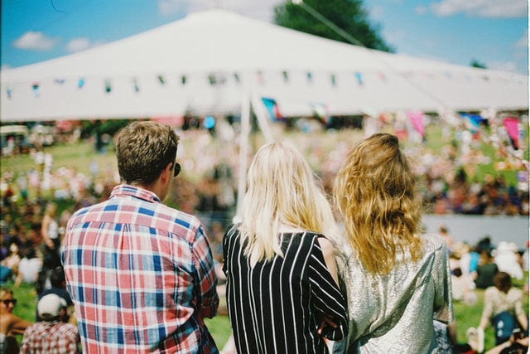
St. Andrew’s Church Fete
The Old Vicarage, Great Staughton
CASH PREFERRED
Saturday 12th September : 2.00 - 4.00
Raffle
Cake Stall
Fresh Produce Stall
Bottle Stall
3 in a row
and more…

